Slide 1

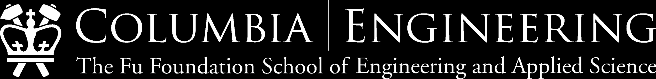
SqueezeNet
EECS 6699: Mathematics for Deep Learning
Project Presentation
Apurva Patel (amp2365)
Harsh Benahalkar (hb2776)
Devika Gumaste (dg3370)
Spring 2024

Slide 2
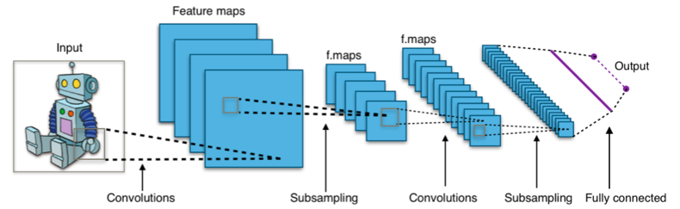
Traditional Convolution Neural Networks
(CNNs)
Complex Data Processing: CNNs are designed to handle complex data structures like images, videos, and audio, which have high-dimensional data representations.
Feature Extraction: CNNs excel at automatically learning hierarchical patterns and features from raw data. Through successive convolutional and pooling layers, CNNs can identify low-level features like edges and textures, gradually building up to higher-level features like shapes, objects, and semantic concepts.
Applications in Computer Vision: CNNs have revolutionized the field of computer vision by enabling tasks such as image classification, object detection, facial recognition, and image segmentation with unprecedented accuracy.
‹#› | CNN

Slide 3
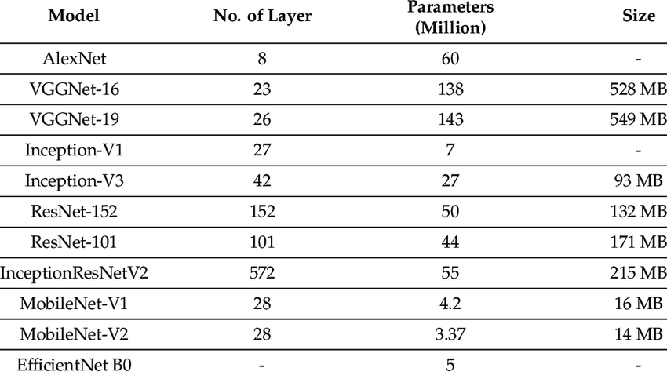
Motivation
Why do we need smaller models?
Lack of compute resources as the cloud and storage industry is not advancing as exponentially as the Deep Learning industry is.
Increasing complexity of models to adapt to future use cases where autonomous systems have been integrated into society.
Need to deploy models on edge/mobile devices to remove the barrier of Deep Learning as just a cloud/remote deployable system.
How does SqueezeNet solve this problem
The need for squeezenet is justified by the model size which has just about 1.2M parameters.
Comes handy when use cases demand of real time edge computing without significant performance drop and onboard memory is limited.
Some models with their footprint size and number of parameters
‹#› | CNN

Slide 4
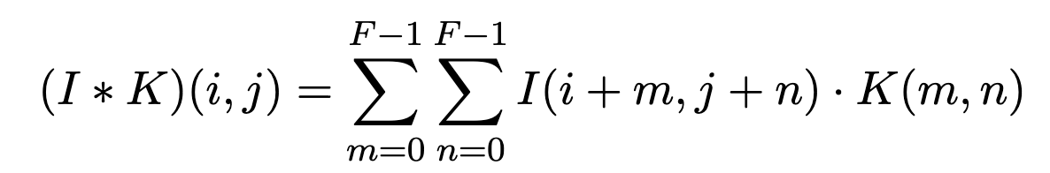
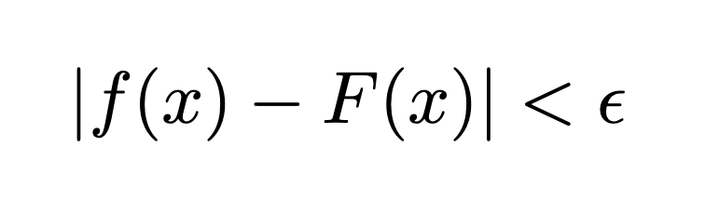
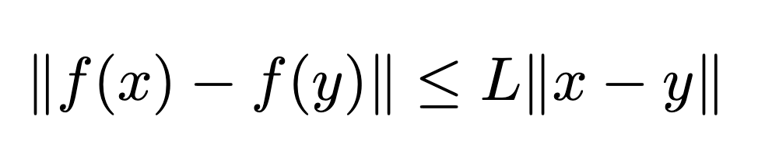
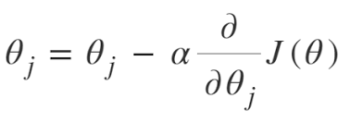
Principal Theorems
Wiener-Khinchin theorem (cross-correlation):
Wiener-Khinchin theorem is applied to understand the frequency-domain representation of signals.
Universal Approximation theorem:
Universal Approximation Theorem assures that a neural network with at least one single hidden layer can approximate any continuous function.
Lipschitz Continuity of Neural Networks:
Lipschitz continuity ensures stability and smoothness of neural network outputs with respect to small changes in inputs.
Gradient Descent algorithm:
Gradient descent efficiently updates neural network parameters by iteratively minimizing a loss function.
‹#› | Mathematics involved

Slide 5
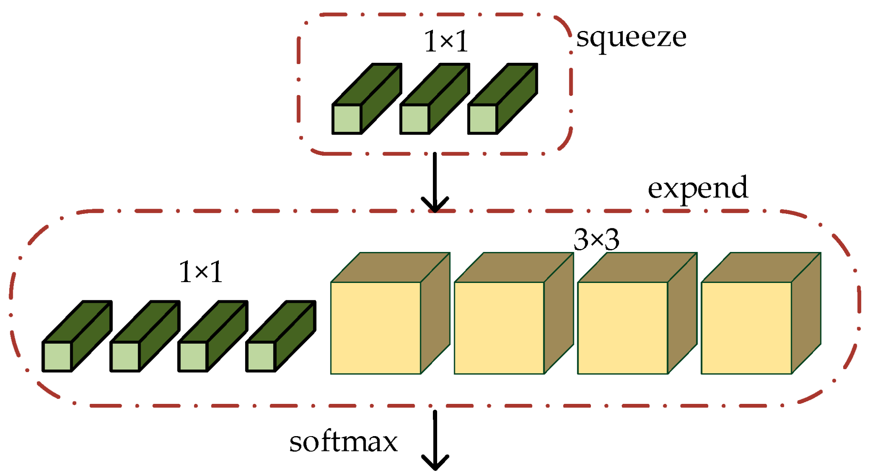
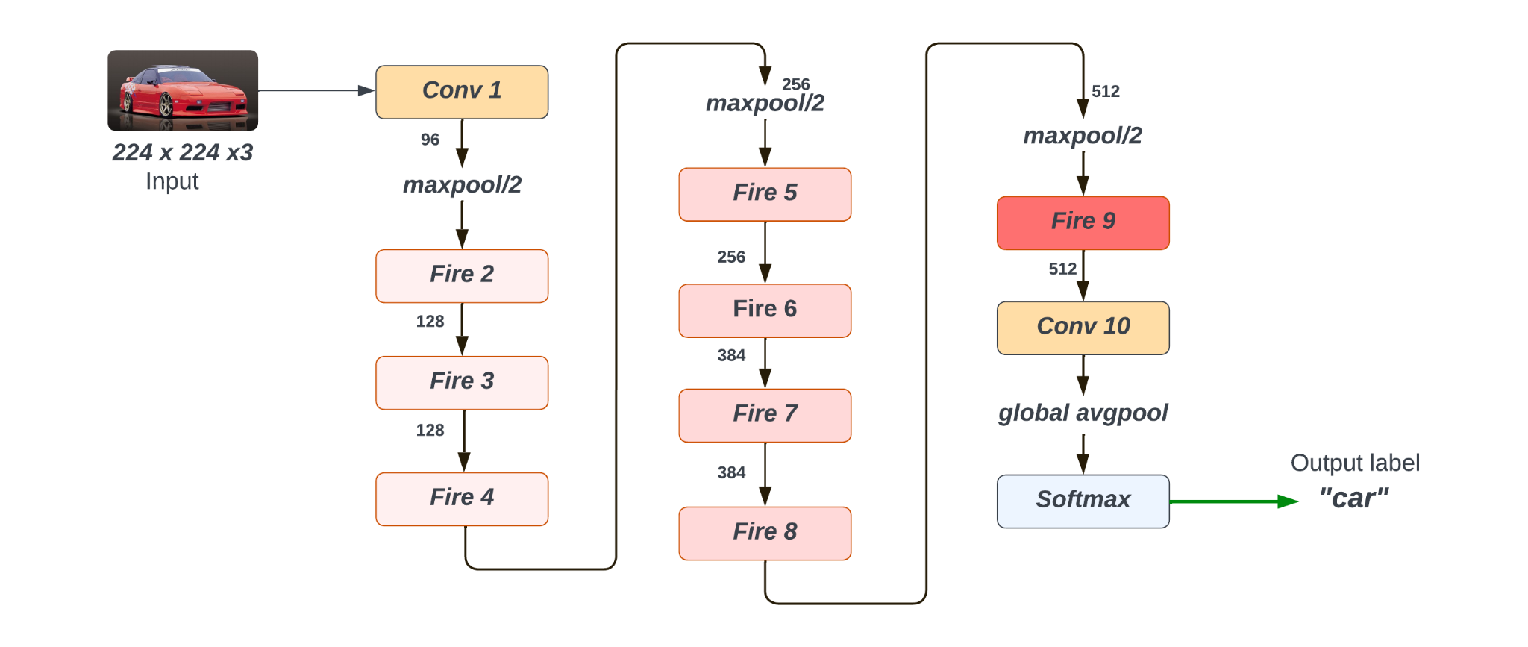
SqueezeNet Architecture
Fire module representation
Stages of the Fire module:
Compression
Replacing 3x3 filters with 1x1 filters (squeeze layers).
Downsampling feature maps.
Expansion
Applying 1x1 and 3x3 convolution on the input parallelly.
1x1 keeps input dimension intact and the 3x3 filter captures spatial features.
Concatenation
Channel-wise addition of 1x1 and 3x3 convolutions.
Activation
Introduces non-linearity in the module.
Vanilla squeezenet architecture
‹#› | SqueezeNet
Notes:
Predicting the success of movies has been of interest to economists and investors (media and production houses) as well as predictive analysts. A number of attributes such as cast, genre, budget, production house, PG rating affect the popularity of a movie. Social media such as Twitter, YouTube etc. are major platforms where people can share their views about the movies. This paper describes experiments in predictive analysis using machine learning algorithms on both conventional features, collected from movies databases on Web as well as social media features (text comments on YouTube, Tweets)

Slide 6
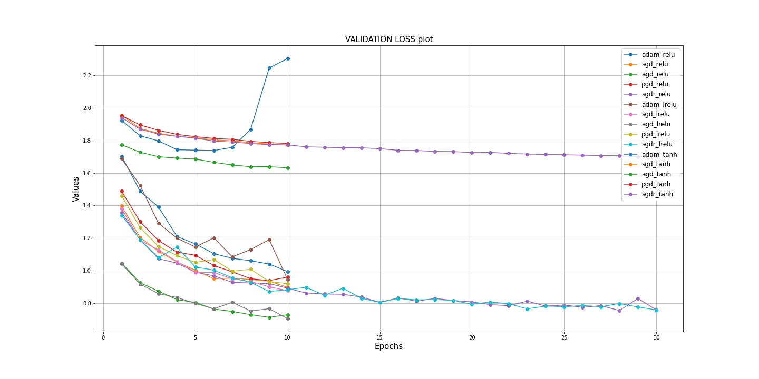
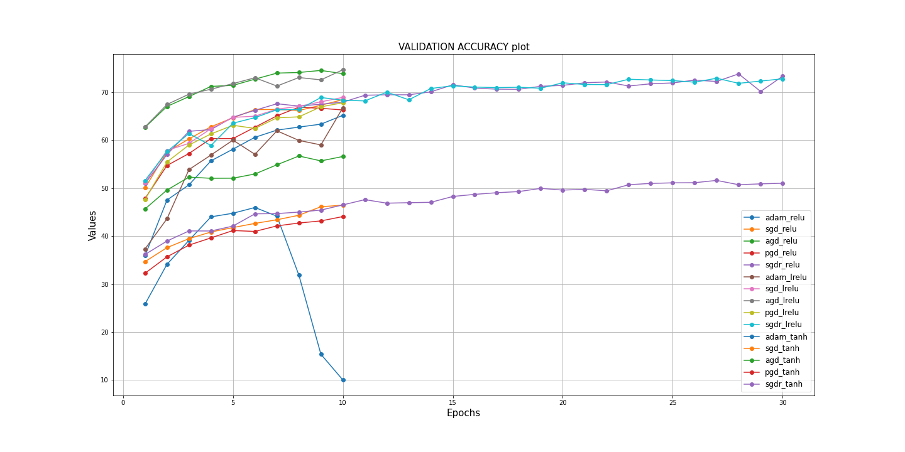
Experiments
Optimizers used:
Adaptive Moment (Adam)
Stochastic Gradient Descent (SGD)
Perturbed Gradient Descent (PGD)
Accelerated Gradient Descent AGD (SGD with momentum)
SGD with restart
Activations used:
ReLU
Leaky ReLU
TanH
No. of parameters: 740554
Model Size after training: 11.3 Mb
‹#› | Experiments
Notes:
Predicting the success of movies has been of interest to economists and investors (media and production houses) as well as predictive analysts. A number of attributes such as cast, genre, budget, production house, PG rating affect the popularity of a movie. Social media such as Twitter, YouTube etc. are major platforms where people can share their views about the movies. This paper describes experiments in predictive analysis using machine learning algorithms on both conventional features, collected from movies databases on Web as well as social media features (text comments on YouTube, Tweets)

Slide 7
Our Implementations
Dense Sparse Dense Training
Squeezenet with Residual Connections
‹#› | New Strategies

Slide 8
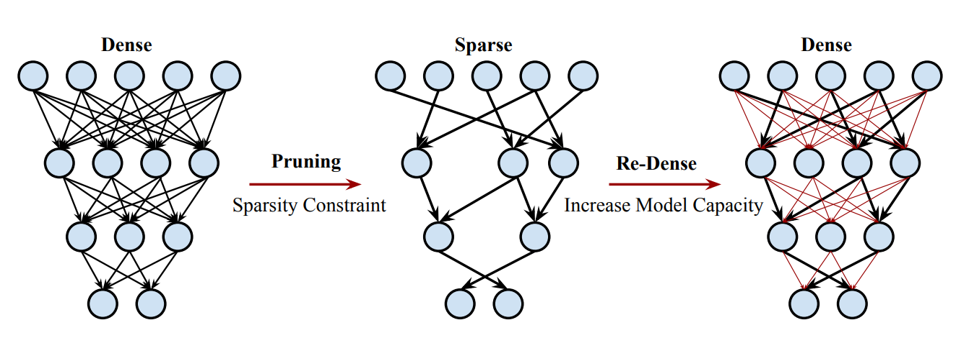
Dense-Sparse-Dense Training
Motivation: Large complicated models are prone to capturing noise, rather than finding the intended pattern in the dataset, leading to overfitting and high variance. Simply reducing the model capacity leads to underfitting and high bias.
Approach: The authors of the parent paper propose a new solution - “Dense Sparse Dense” approach - a novel training strategy that starts with conventional training, then regularizes the model with sparsity- constrained optimization, and finally increases the model capacity by restoring and re-training the pruned weights.
‹#› | DSD

Slide 9
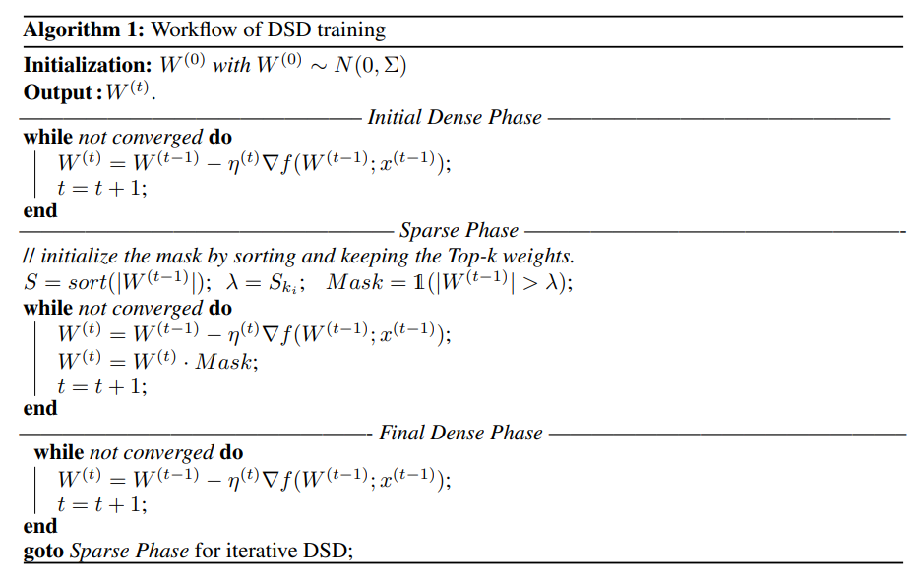
DSD Algorithm Overview
Three step process -
Initial Dense Training
Regularization with sparse training
Final Dense Training by restoring and re-training the pruned weights
‹#› | DSD

Slide 10
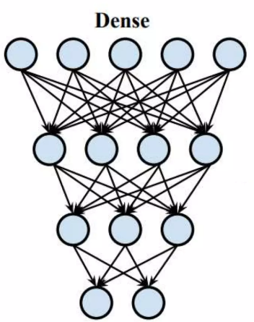

Phase-1 Dense Training
Dual Objective
The first step focuses on training the network using all connections.
The network learns both the values of the weights and identifies the important connections.
The importance of connections is quantified by simply taking the absolute value of the weights - weights with higher absolute values are considered important.
‹#› | DSD

Slide 11
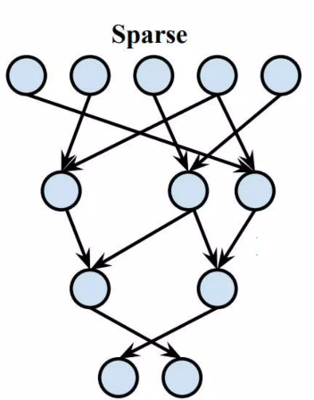
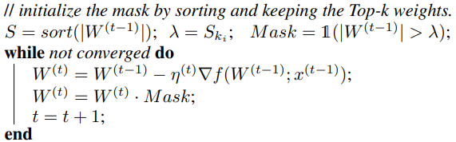
Phase-2 Sparse Training
Connecting with low weights are pruned to induce sparsity. The degree of sparseness is controlled by a hyperparameter “sparsity”.
Threshold = kth largest weight, where k=N(1 - sparsity).
Binary Mask is generated for each layer to prune weights.
Network is trained while enforcing the binary mask
‹#› | DSD

Slide 12
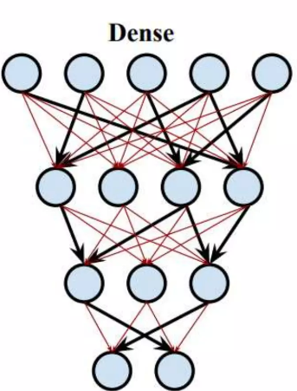
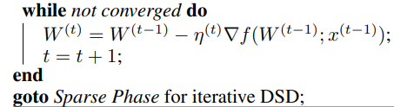
Phase-3 Dense Training
Initially pruned connections are recovered and initialized anew
Entire network is trained on a reduced learning rate (1/10th) of the original rate - since the sparse network is already close to a good local minimum.
Other hyperparameters remain unchanged to maintain consistency and stability in the training process.
Final dense training enhances capacity of the model - allowing the model to reach to a better local minimum.
‹#› | DSD

Slide 13
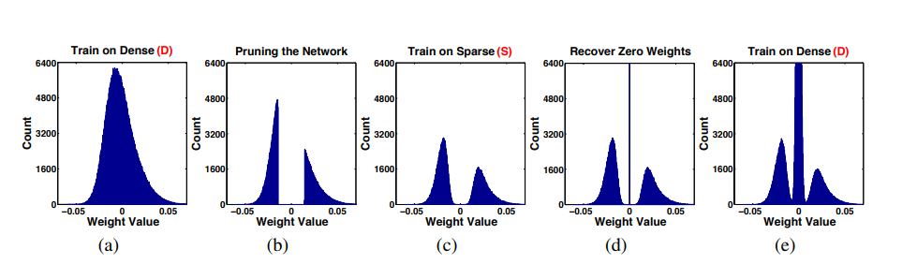
DSD Weights Visualization
Weight distribution is initially centered around zero with rapid tail decay.
Pruning based on absolute value truncates the central region, leading to a bimodal distribution during retraining.
Pruned weights are then re-initialized to zero at the start of re-dense training and eventually retrained alongside un-pruned weights.
‹#› | DSD

Slide 14
DSD Experiments
Varying Sparsity Levels
Sparsity Level is systematically varied to observe it’s effects on performance.
Optimal sparsity level between 25-50%
For our set-up, optimal sparsity turned out to be 40%
Trade-off between sparsity and accuracy
Different Epochs Distribution
Distribution of dense and sparse epochs
Instead of allocating equal number of epochs to each phase, tested out different combinations.
Differences observed in accuracy and training time
5 - 3 - 5 resulted in best performance
‹#› | DSD

Slide 15
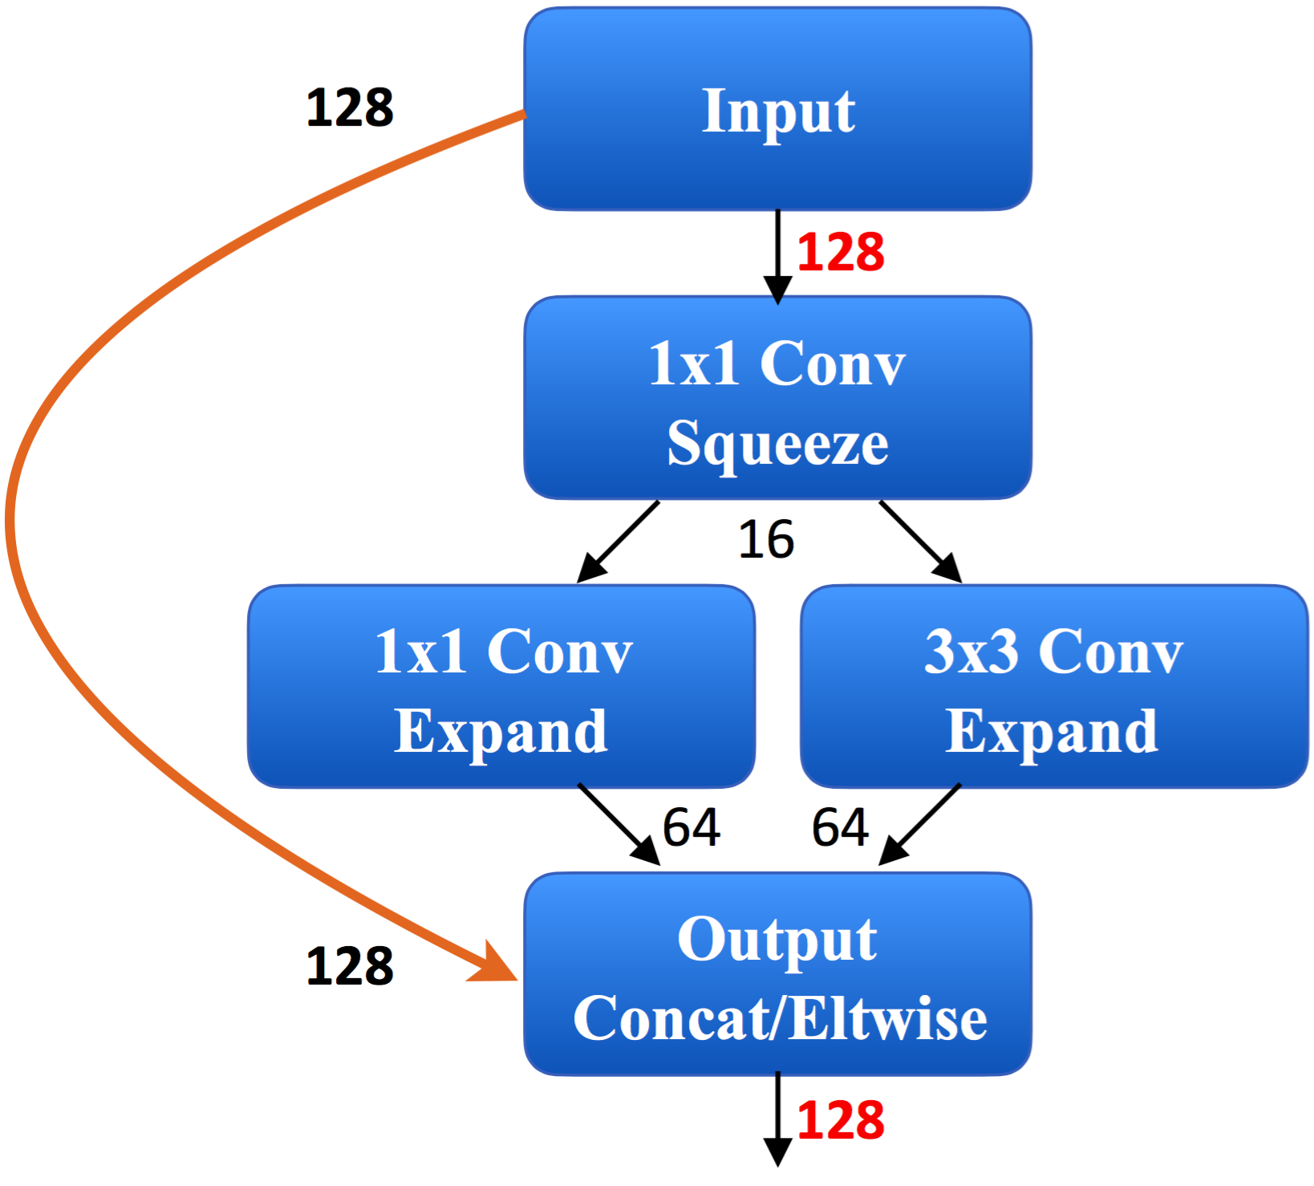
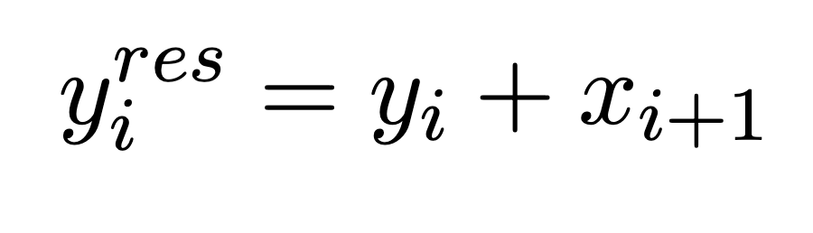
Residual connections
SqueezeNet with residual connections
Motivation: Helps reformulate the underlying mapping as a residual mapping, rather than expecting the stacked layers to directly fit a desired underlying mapping.
If the desired underlying mapping is H(x), the residual learning framework lets the layers fit another mapping
F(x) = H(x) + x, where x is the input to the layer.
Fire module with residual connections between layers to improve backpropagation of error.
‹#› | Residual SqueezeNet

Slide 16
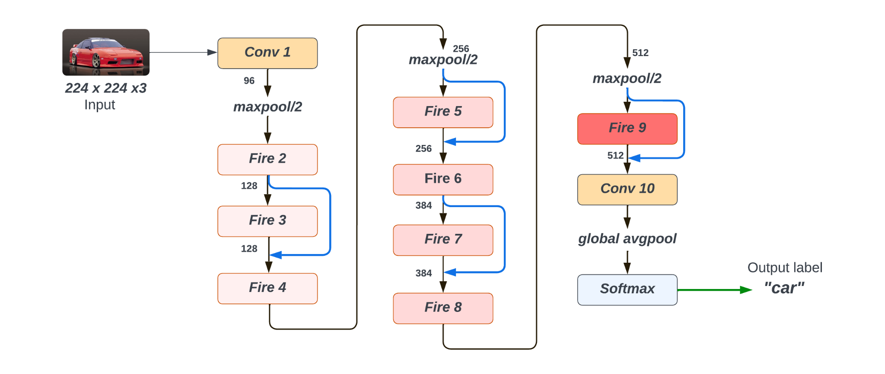
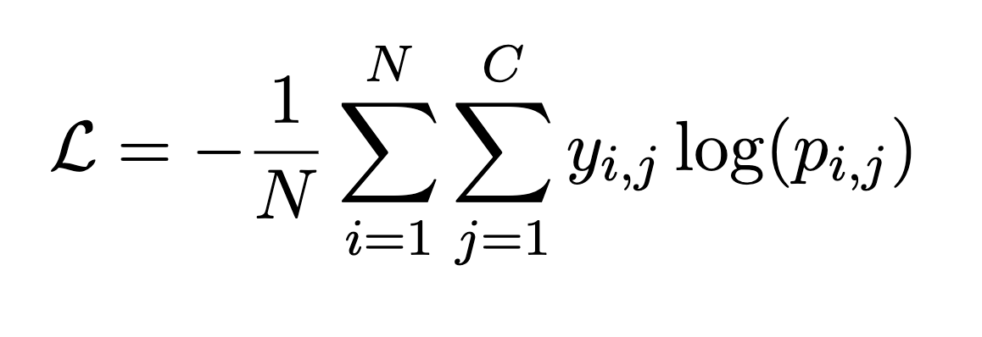
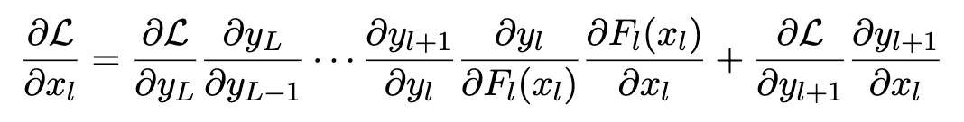
Residual connections
SqueezeNet architecture with residual connections
Cross-Entropy loss function
Error computation for backpropagation
The key difference is the addition of the second term which represents the gradient flowing through the residual connection, and the residual connection ensures that the gradients can be expressed as a sum of two terms, where one term is not subject to the exponential decay caused by the product of derivatives.
This residual connection provides an alternative path for the gradients to flow, bypassing the potentially vanishing gradients through the layers. As a result, the gradients can be maintained and effectively propagated to the earlier layers, mitigating the vanishing gradient problem
‹#› | Residual SqueezeNet

Slide 17
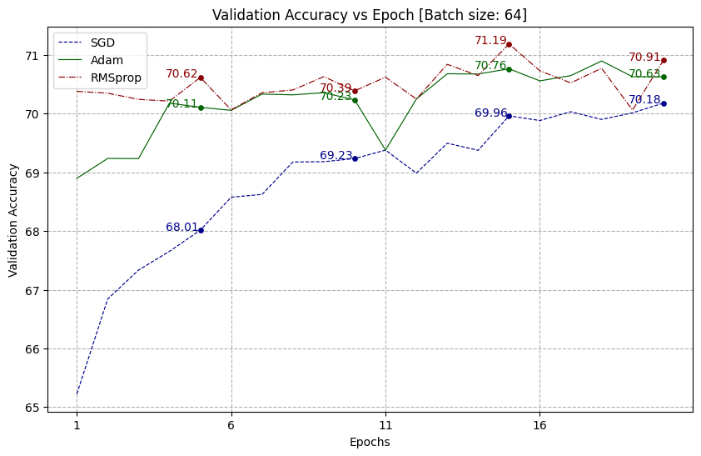
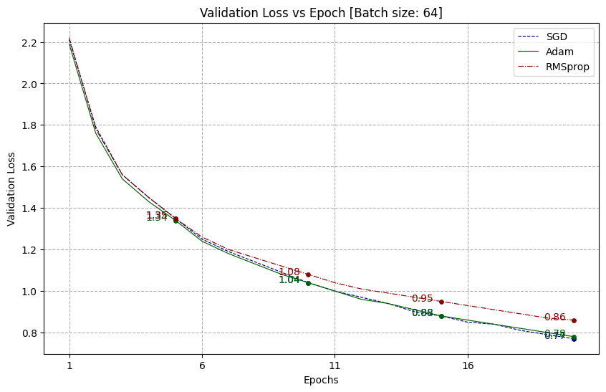
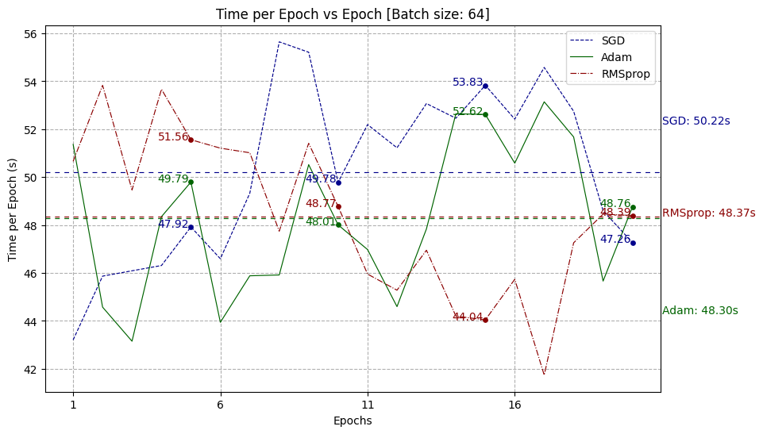
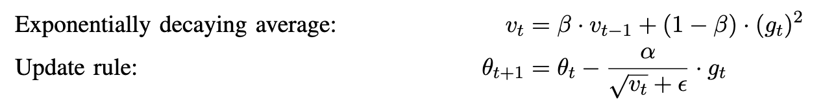
Results & Discussions
Batch Size: 64
Learning rate: 0.001
for RMSProp:
RMSprop adapts the learning rates for each parameter based on the root mean square (RMS) of recent gradients. This adaptiveness allows it to converge faster and more robustly, especially in scenarios where the gradients exhibit large variations or are sparse.
Average time(s) per epoch is highest for SGD as the no of updations required in that during the update rule is slightly higher than that ADAM and RMSProp where update takes place without momentum instead utilizing adaptive gradient.
Note: Time per epoch is a very lucrative measure as it is highly dependant on instruction pipeline and so we consider average time per epoch
‹#› | Residual SqueezeNet

Slide 18
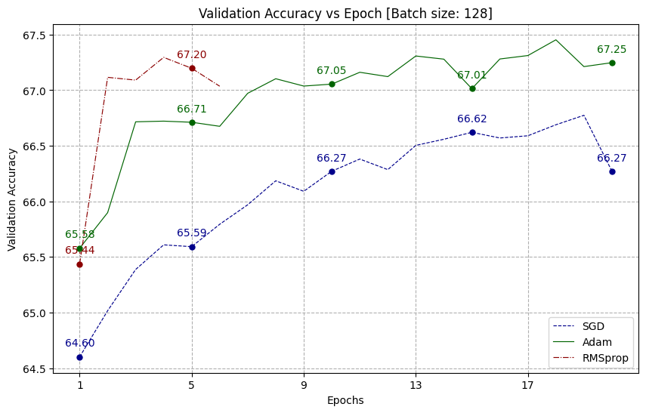
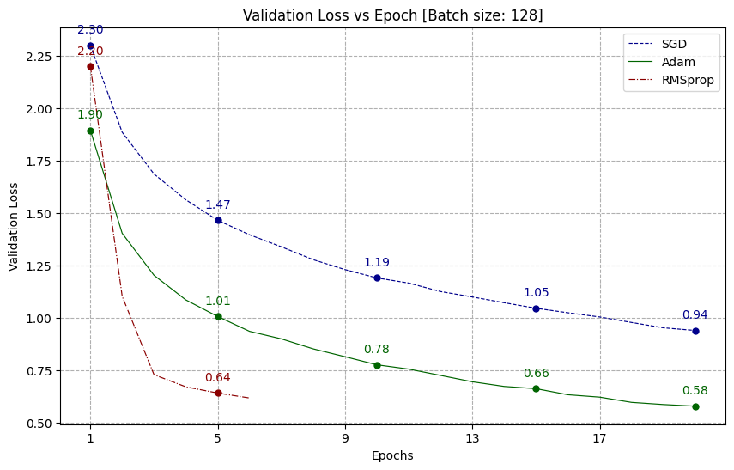
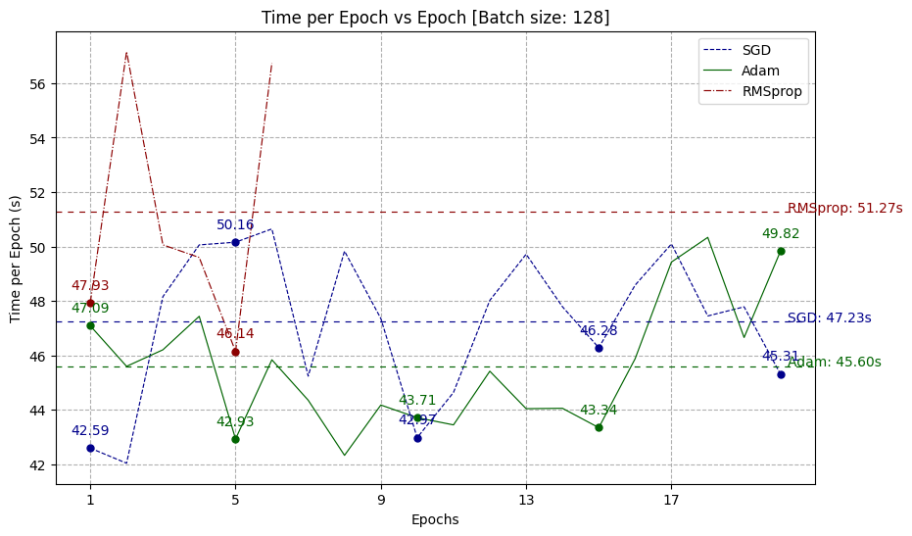
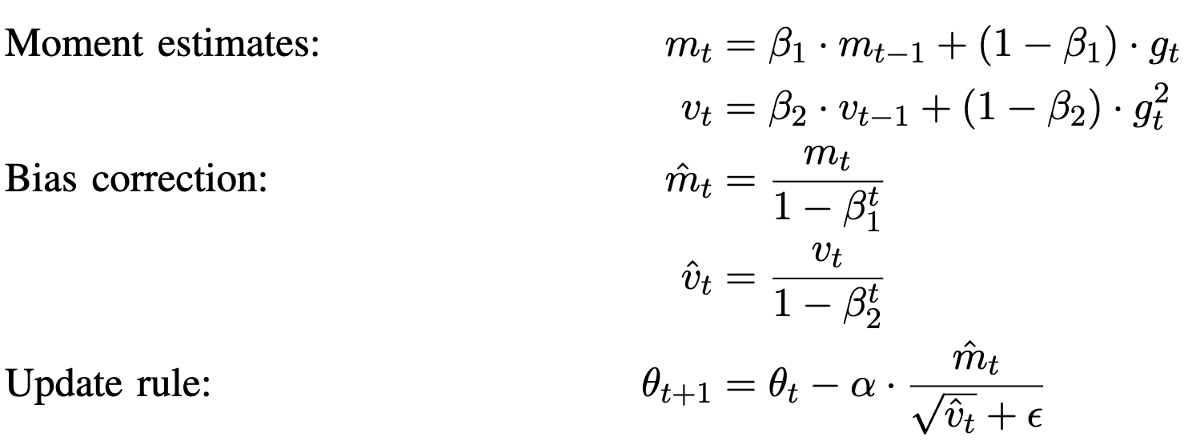
Results & Discussions
Batch Size: 128
Learning rate: 0.001
Note: With a large batch size of 128 RMSProp crashes as the computations are large and calculation of moments becomes complex with a complexity of O(2n²)
for ADAM:
The adaptive moment estimation formulae dynamically adjust the learning rates, first moment estimates, and second moment estimates using exponential decay rates.
This adaptiveness allows Adam to efficiently navigate varying gradients and converge to more optimal parameter values, resulting in improved training accuracy and lower validation loss over epochs compared to traditional optimizers like SGD and RMSprop.
‹#› | Residual SqueezeNet

Slide 19
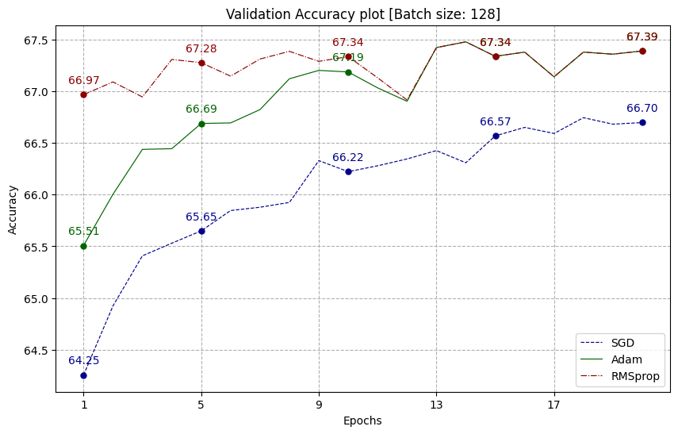
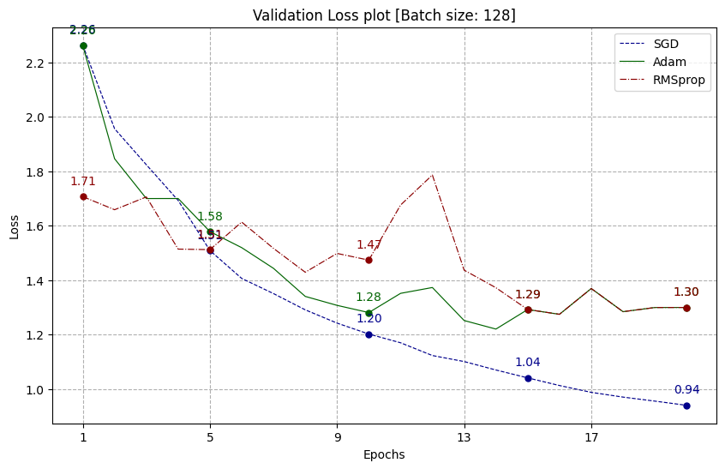
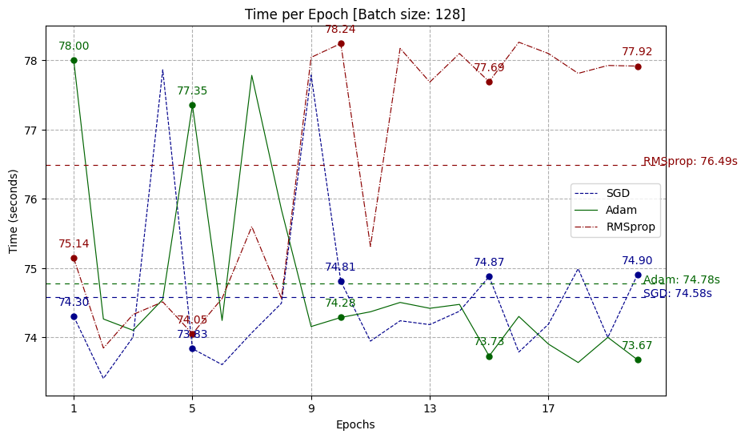
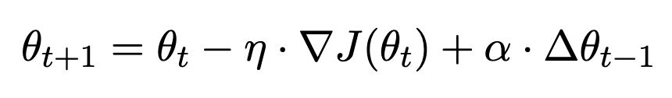
Results & Discussions
Batch Size: 128 with LR scheduler
for SGD with Nesterov momentum:
In complex landscapes like CIFAR10, the momentum term will exacerbate oscillations or hinder convergence in narrow valleys, leading to suboptimal solutions compared to adaptive methods like Adam and RMSprop, which adjust learning rates based on gradient magnitudes.
It is noteworthy to note that despite this the validation loss is lowest, which can be explained by the momentum being taken into consideration and making the “distance” closest to global minima.
Also varying learning rate doesn’t help in RMSProp in our case because moment updation will be costly
‹#› | Residual SqueezeNet

Slide 20
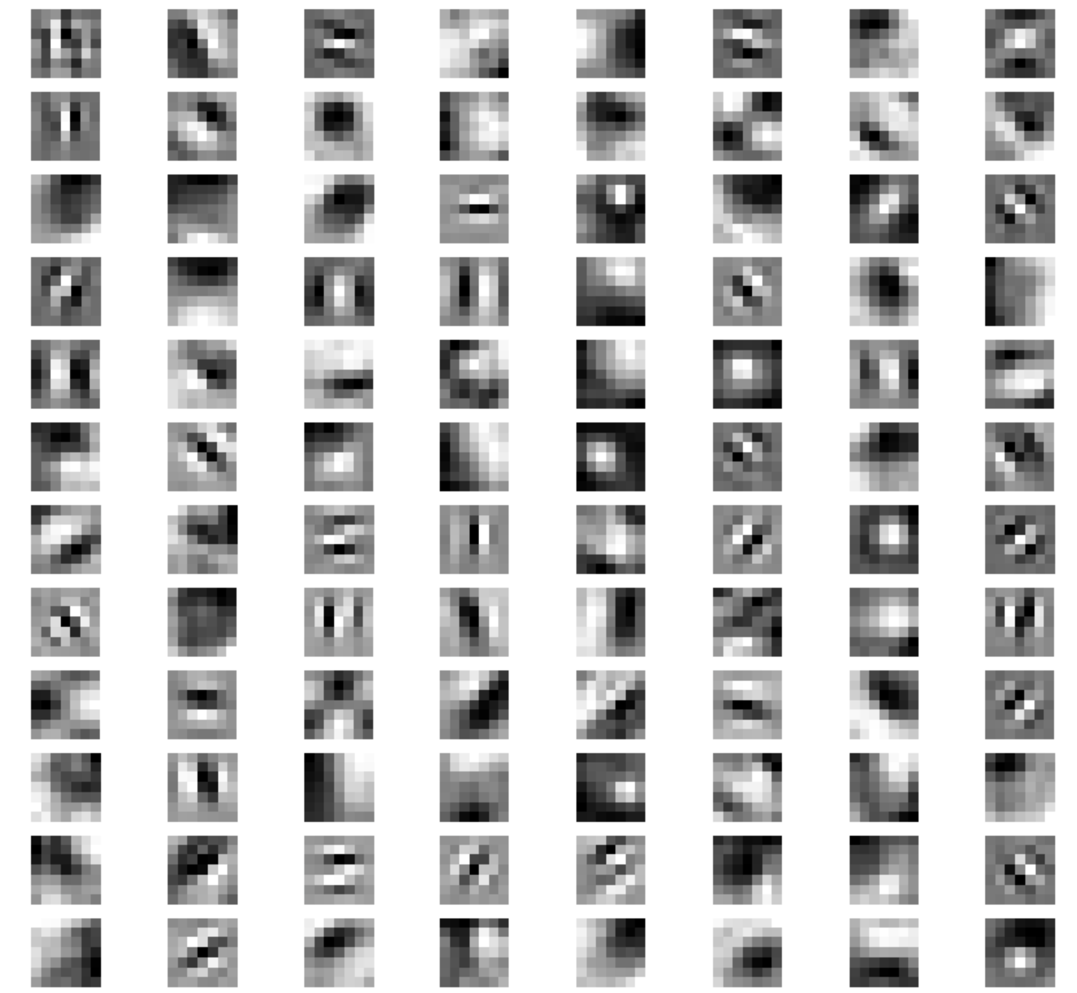
Results & Discussions
Weights clearly are much more distributed than the vanilla squeezenet implementation.
Residual connections helped backpropagate the error and not vanish the gradients with lower values.
Propagation of error signals through the network more effectively, residual connections have enabled the model to learn richer and more nuanced representations of the input data.
Sample weights in conv1 layer
‹#› | Residual SqueezeNet

Slide 21
Thank You :)
‹#› |

